Slide 1
Big-O Notation
CS 201, Summer 2013

Slide 2
ADDITIONAL READING
Big-O Notation
  http://www.cprogramming.com/tutorial/computersciencetheory/algorithmicefficiency1.html
  Big-O Complexity cheat-sheet http://bigocheatsheet.com/

Slide 3
Big-O Notation
Big-O notation is a way to describe how efficient (or how complex) a function or block of code is.
Searching and Sorting methods commonly boast different Big-O ratings.

Slide 4
Big-O Notation
There can be many ways to solve a problem (e.g., searching for an element in an array).
Different methods have different complexity – some are more efficient to run than others.
Good to know efficient ways to process our data so we don't waste a lot of time on a brute-force method or something inefficient. (Takes up processing!)

Slide 5

Big-O Notation
To figure out Big-O, we can look at how many times we'll go through a certain block of code.
For example, if OutputData is called, we know it will run once.
This function is O(1)

Slide 6
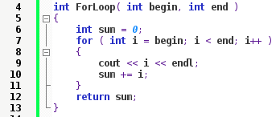
Big-O Notation
For-loop
With a for-loop, we can essentially say this loops n times; we don't need to use concrete numbers.
A simple for-loop is O(n).

Slide 7
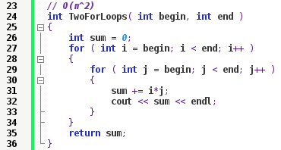
Big-O Notation
Nested for-loops
With nested for-loops, we essentially have multiplication.
Imagine the outer one loops 3 times, and the inner one loops 5 times. We would end up with 15 times through the loop.

Slide 8
Big-O Notation
Nested for-loops
Since we don't care about constants, we can say this is n * n, or O(n²).

Slide 9
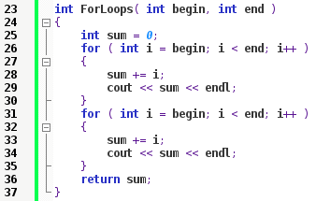
Big-O Notation
Two for-loops
But, if we have two for-loops next to each other – not nested – this will again just be O(n).
We're looping from 0 to n.

Slide 10
Calculating Big-O complexity
Think of n as a count of computations you need to perform.
But at the same time, we don't care about actual numeric counts.
A series of 5 addition statements will still just be O(1).
But once we get to looping, we say that we loop n times.

Slide 11
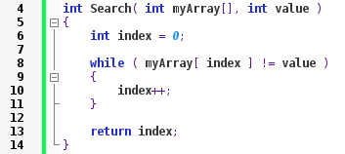
Practice
What is the O(n) value of Search?

Slide 12
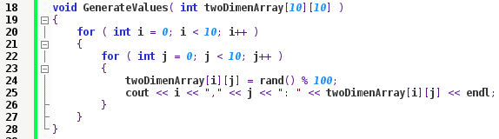
Practice
What is the O(n) value of GenerateValues?

Slide 13
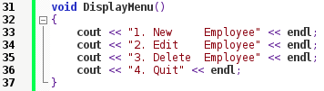
Practice
What is the O(n) value of DisplayMenu?

Slide 14
Beyond O(n)
But there's more than just O(n) and O(n²)
Functions are generally...
  O(1)
  O(n)
  O(n²) or a polynomial
  O(n log(n))
  O(log(n))

Slide 15
Beyond O(n)
But there's more than just O(n) and O(n²)
Functions are generally...
  O(1)
  O(n)
  O(n²) or a polynomial
  O(n log(n))
  O(log(n))

Slide 16
It's difficult to talk about O(log(n)) and
O(n log(n)) without getting into specific algorithms.
O(n) concepts covered more in the Searching & Sorting slides.

Slide 17
References

